Slide 1

CC-215 Database Systems
— Unit 4 — Relational Data Model
Some slides and/or pictures are adapted from Lecture slides / Books of
Peter Rob
Jeffery. A. Hoffer
Thomas M. Connolly
Ramez Elmasri
Silberschtaz
Dr. Asif Sohail University of the Punjab Department of Information Technology, FCIT

Slide 2
Relational Data Model (RDM)
A Relation is a mathematical concept based on the ideas of sets.
It was first proposed by Dr. E.F. Codd of IBM Research in 1970 in a research paper "A Relational Model for Large Shared Data Banks," Communications of the ACM, June 1970.
The RDM caused a major revolution in the field of database.
Unlike navigational approach of HDM and NDM, RDM follows declarative approach (need to specify what (not how) the data is to be retrieved).
RDM is widely used database model and now the terms DBMS and RDMBS (Relational DBMS) are used interchangeably.
It represents data in form of relations.
A Relation (sometimes called a Table) is a 2-dimsnesional table of data consisting of rows & columns.

Slide 3
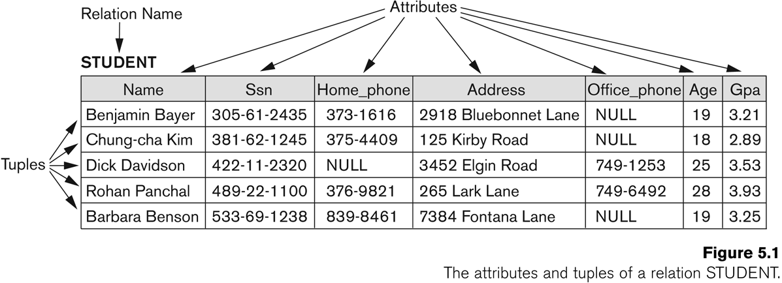
Relational Data Model (RDM)
A Row in a relation is also called Tuple (values are written inside angular brackets <…>)
Number of tuples in a relation is called Cardinality of the relation.
Number of columns/attributes in a relation is called Degree or arity of the relation.
Each attribute has a Domain (set of valid values and format).

Slide 4
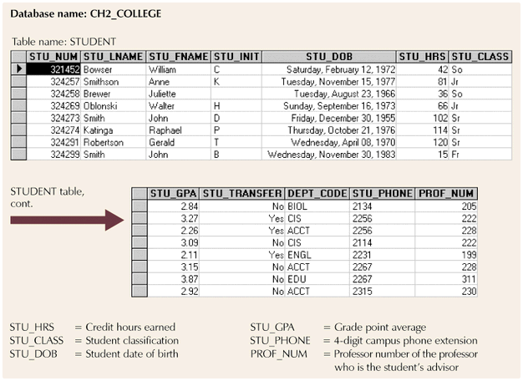
Relational Data Model (RDM)
Entity set
Column (attribute)
value
Row
entity

Slide 5
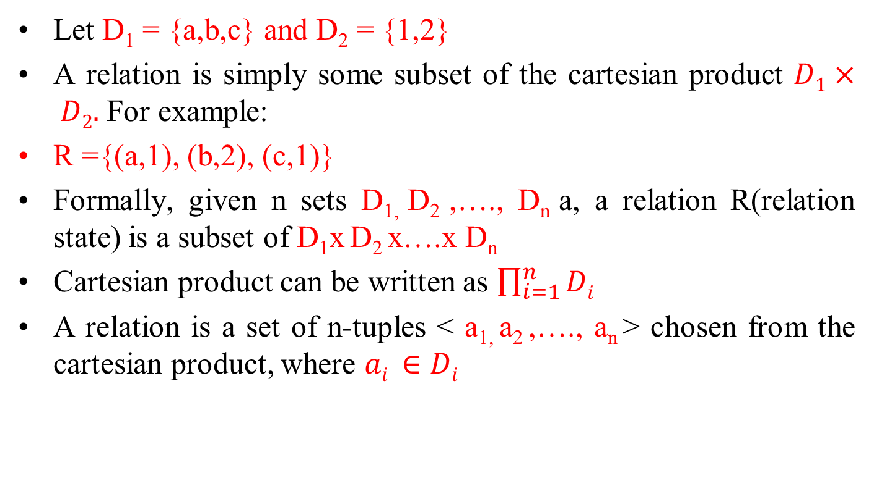
Relational Data Model (RDM)

Slide 6
Relational Data Model (RDM)
A relation consists of two parts:
Heading consisting of fixed set of attributes or columns.
Body or State of a relation consists of time varying set of tuples.
Let A₁, A₂, …, A_{n} be attributes with domains D₁, D₂, …, D_{n}
A relation schema or description of a relation is written as:
R(A₁, A₂, …, A_{n})
A RDM consists of 3 components:
Data Structure: Data are organized in the form of tables or relations.
Data Manipulation: Powerful operations using SQL.
Data Integrity: To ensure the correctness of data.

Slide 7
Properties of a Relation
Each relation in a database has a unique name.
Each column has a distinct name.
Each row is unique.
Entries in columns are from the same domain.
Each row/column intersection must have single or atomic value.
The order of column (left to right) is insignificant.
The order of rows (top to bottom) is insignificant.

Slide 8
Terminologies of a Relation
Informal Terms | Informal Terms
Table | Relation, Entity Set
Column or Field | Attribute
All possible Column Values | Domain
Row or Record | Tuple
Table Definition | Schema of a Relation
Populated Table | State of the Relation

Slide 9
Relational Keys
Super Keys
Candidate Key(s)
Composite Key
Primary Key (PK)
Natural Key
Surrogate Key
Alternate or Unique Key(s)
Secondary Key(s)
Sort Key(s)
Foreign Key (FK)

Slide 10
Relational Keys
Determination (A -> B)
A determines B (A is called determinant)
Using the value of A, value of B can be uniquely determined OR attribute B is functionally dependent on attribute A.
STU_NUM → STU_NAME, STU_DOB, STU_CLASS
Each value in column A determines one and only one value in column B.
All of the rows in a table that agree on value for attribute A also agree in value for attribute B.

Slide 11
Relational Keys
Relational Schema Example
EMP (empno, ename, job, sal, cnic, email, empid, deptno)
DEPT (deptno, dname, loc)
PROJECT (pno, p_desc, start_date, budget, pmgr)
PROJ_EMP (pno, empno, alloc_date, emp_role)
Business Rule
empno is unique for all the employees.
empid is unique within a department.
An employee can be assigned many projects, and vice-vresa.

Slide 12
Relational Keys
1. Super Keys
An attribute or a set of attributes that uniquely identifies a tuple within a relation.
A set of all the attributes of a relation is one of many possible super keys of a relation.
Formally, if K is a super key of a relation R, then two distinct tuples t₁ and t₂ cannot have identical values on attributes of K. i.e., if t₁ ≠ t₂, then t₁[K] ≠ t₂[K].
A super key may contain extraneous attributes that are not necessary for achieving uniqueness.
If K is a super key, then so is any superset of K.
Examples: empno, empno+ename, job+cnic, etc.

Slide 13
Relational Keys
2. Candidate Key(s)
Minimal set of attributes that uniquely identifies each instance of an entity type.
Minimal super keys are the super keys whose any of the proper subsets cannot be a super key.
A candidate key K of a relation R has two properties;
a) Uniqueness
b) Minimality or Irreducibility
Examples: empno, cnic, email, empid+deptno.

Slide 14
Relational Keys
3. Composite Key
Sometimes a single attribute is not sufficient to uniquely identify a tuple. In such situations, two or more attributes are combined together to form a key and such a key is called Composite Key.
A Composite Key must satisfy the conditions of uniqueness & minimality i.e., Elimination of any part of key should will destroy uniqueness.
A particular type of a composite key is a compound key in which each attribute is a foreign key
Example: empid+deptno.

Slide 15
Relational Keys
4. Primary Key
It is an attribute or combination of attributes that is selected as an identifier for an entity type OR the candidate key that is selected for unique identification of tuples of a relation.
Primary key values are not allowed to accept NULL value
Primary key can uniquely determine the values of other attributes of the relation.
A primary key can either be a Natural Key or Surrogate Key.
Natural key is a key that has contextual or business meaning. For ex., CNIC, EmpNo, CourseCode, CustID, etc.
Surrogate Key is a system generated key that is manufactured “artificially”. For Ex., row-ids or sequential numbers. Surrogate keys are used in the following situations:
Absence of a suitable natural key
Data Warehousing

Slide 16
Relational Keys
5. Alternate or Unique Key(s)
Keys left behind after the selection of the primary key among the possible candidate keys of a relation. For Ex: empno, cnic, email, empid+deptno are candidate keys of EMP table. If empno is chosen as the Primary Key then cnic, email, empid+deptno will be the Alternate Keys.
Unique key(s) may assume NULL values.

Slide 17
Relational Keys
7. Secondary Key(s)
An attribute or combination of attributes used strictly for data retrieval purposes.
In case of unavailability of primary key value, secondary key(s) provides an alternate way to access a certain record(s). For Ex: ename+hiredate of an employee.
Secondary key does not necessarily yield a unique outcome.
8. Sort Key
It is used for arranging data in a certain order.
For Ex: List all the employees in alphabetical order with respect to their names.

Slide 18
Relational Keys
8. Foreign Key (FK)
The RDM uses a set of relations liked together by a key called foreign key.
The FK is an attribute of one relation called referencing relation whose values are required to match the primary key of another relation called referenced or target relation.
Foreign keys are the glue holding the database together. Without foreign keys, the data is like leaves covering the ground in fall – you know that each leave fell from one of the trees, but it is impossible to say from which one.

Slide 19
Relational Keys
8. Foreign Key (FK)
Consider the following two relations:
R1: EMP(EmpNo, EName,…,DeptNo) R2: DEPT(DeptNo, DName)
The values of DeptNo in the EMP relation should either be one of the values stored in DEPT relation or it may optionally be NULL.
Table Name: EMP
Table Name: DEPT
EMPNO ENAME JOB DEPTNO
7839 KING PRESIDENT 10
7698 BLAKE MANAGER 30
7782 CLARK MANAGER 10
7566 JONES MANAGER 20
DEPTNO DNAME LOC
10 ACCOUNTING NEW YORK
20 RESEARCH DALLAS
30 SALES CHICAGO
40 OPERATIONS BOSTON
Primary key
Foreign key
Primary key

Slide 20
Relational Database Schema
A relational database schema S is a set of relation schemas S = {R₁, R₂, … , R_{m}} and a set of Integrity Constraints IC.
A relational database state (or snapshot) DB of S is a set of relation states DB = {r₁, r₂, … , r_{m}} such that each r_{i} is a state of R_{i} and such that the r_{i} relation states satisfy the integrity constraints specified in IC.
A legal or valid state of the database is one that obeys all the integrity constraints.

Slide 21
Integrity Constraints or Integrity Rules
To maintain the accuracy & integrity of data in the database
There are the following classes and Types of Integrity Constraints:
a) Static or Schema Constraints
Domain Constraints
NOT NULL Constraint
Entity Integrity
Referential Integrity
b) Dynamic Constraints
Action Assertion / Business Rules / Semantic Integrity Constraints

Slide 22
Integrity Constraints or Integrity Rules
1. Domain Constraints
Domain: Set of values that may be assigned to an attribute
Attribute | Description | Data Type
Empno | Primary Key | Character : size 5
Emp_Name | NOT NULL | Character : size 25
Job | CLERK, MANAGER, SALESMAN etc. | Character : size 15
Sal | Between 6000 and 40000 | Numeric : size 5
Rank | 1, 2, 3, 4, or 5 | Numeric : size 1

Slide 23
Integrity Constraints or Integrity Rules
2. NOT NULL Constraints
It enforces that an attribute Ai of a relation R must have some value. For example: If student tuple must have a valid, non-Null value for the Name attribute, then Name of STUDENT is required to be NOT NULL.
3. Entity Integrity
All PK entries are unique
No Component of the PK of a relation is allowed to have NULL values.
Note: Some other attributes of a relation may also be constrained to disallow null values, even though they are not members of the primary key.
Formally, t[PK] ≠ null for any tuple t in r(R)

Slide 24
Integrity Constraints or Integrity Rules
4. Referential Integrity
It is a constraint involving two relations called referencing relation and referenced or target relation.
It specifies a relationship among tuples in two relations.
A tuple t1 in R1 (referencing relation) is said to reference a tuple t2 in R2 (referenced relation) if t1[FK] = t2[PK].
The database must not contain any unmatched FK values.
The value in the foreign key column (or columns) FK of the referencing relation R1 can be either:
A value of an existing primary key value of a corresponding primary key PK in the referenced relation R2, or
a null.
In case (2), the FK in R1 should not be a part of PK of its containing relation.

Slide 25
Integrity Constraints or Integrity Rules
4. Referential Integrity
CUSTOMER
Customer_ID
Customer_Name
Address
City
State
Zip
ORDER
Order_ID
Order_Date
Customer_ID
ORDER_LINE
Order_ID
Product_ID
Quantity
PRODUCT
Product_ID
Prduct_Desc
Product_Type
Standard_Price
Sock

Slide 26
Integrity Constraints or Integrity Rules
4. Referential Integrity
What should happen if an attempt is made to delete a record from a target table, while some matching records exist in the referencing table?
There are three possible options:
Not Allowed. This is the default option.
Cascade: All the matching records in the referencing table will also be deleted.
Nullify: Null will be placed in the FK. This option is only applicable if the FK is not a part of PK.

Slide 27
Integrity Constraints or Integrity Rules
b) Dynamic Constraints - Action Assertion
Control on the actions of the organization
“An Employee can avail a certain facility only after a certain period of service”.
Unlike the other types of constraints, which are enforced using DDL, action assertion is enforced through some programming logic or triggers.

Slide 28
Schema Diagram
It is the graphical representation of the association or relationship between the relations of a relational database.

Slide 29
Schema Diagram

Slide 30
Reading Material
Database Systems – Design, Implementation and Management: Carlos Coronel, Steven Morris (13th Ed.)
Modern Database Management: Jeffery. A. Hoffer (12th Ed.)
Database Systems: Thomas M. Connolly (6th Ed.)
Fundamentals of Database Systems: Elmasri (7th Ed.)
Database System Concepts: Abraham Silberschatz (7th Ed.)
Databases Illuminated: Catherine M. Ricardo (3rd Ed.)
Book | Section(s) / Chapter
A | 3.1 to 3.3, 3.6 to 3.9
B | Chapter 1 (page 24 to 27)
C | 4.1 to 4.3
D | Chapter 5
E | 2.1 to 2.4
F | 3.4, 4.1 to 4.4

